Slide 1

Introduction to Shiny
Sam Bashevkin
State Water Resources Control Board

Slide 2
What is shiny?
R package to build interactive apps with a graphical user interface.
Practically any R functionality (including external packages) can be used in a shiny app.
Apps can be hosted online and distributed as web pages, or used locally

Slide 3
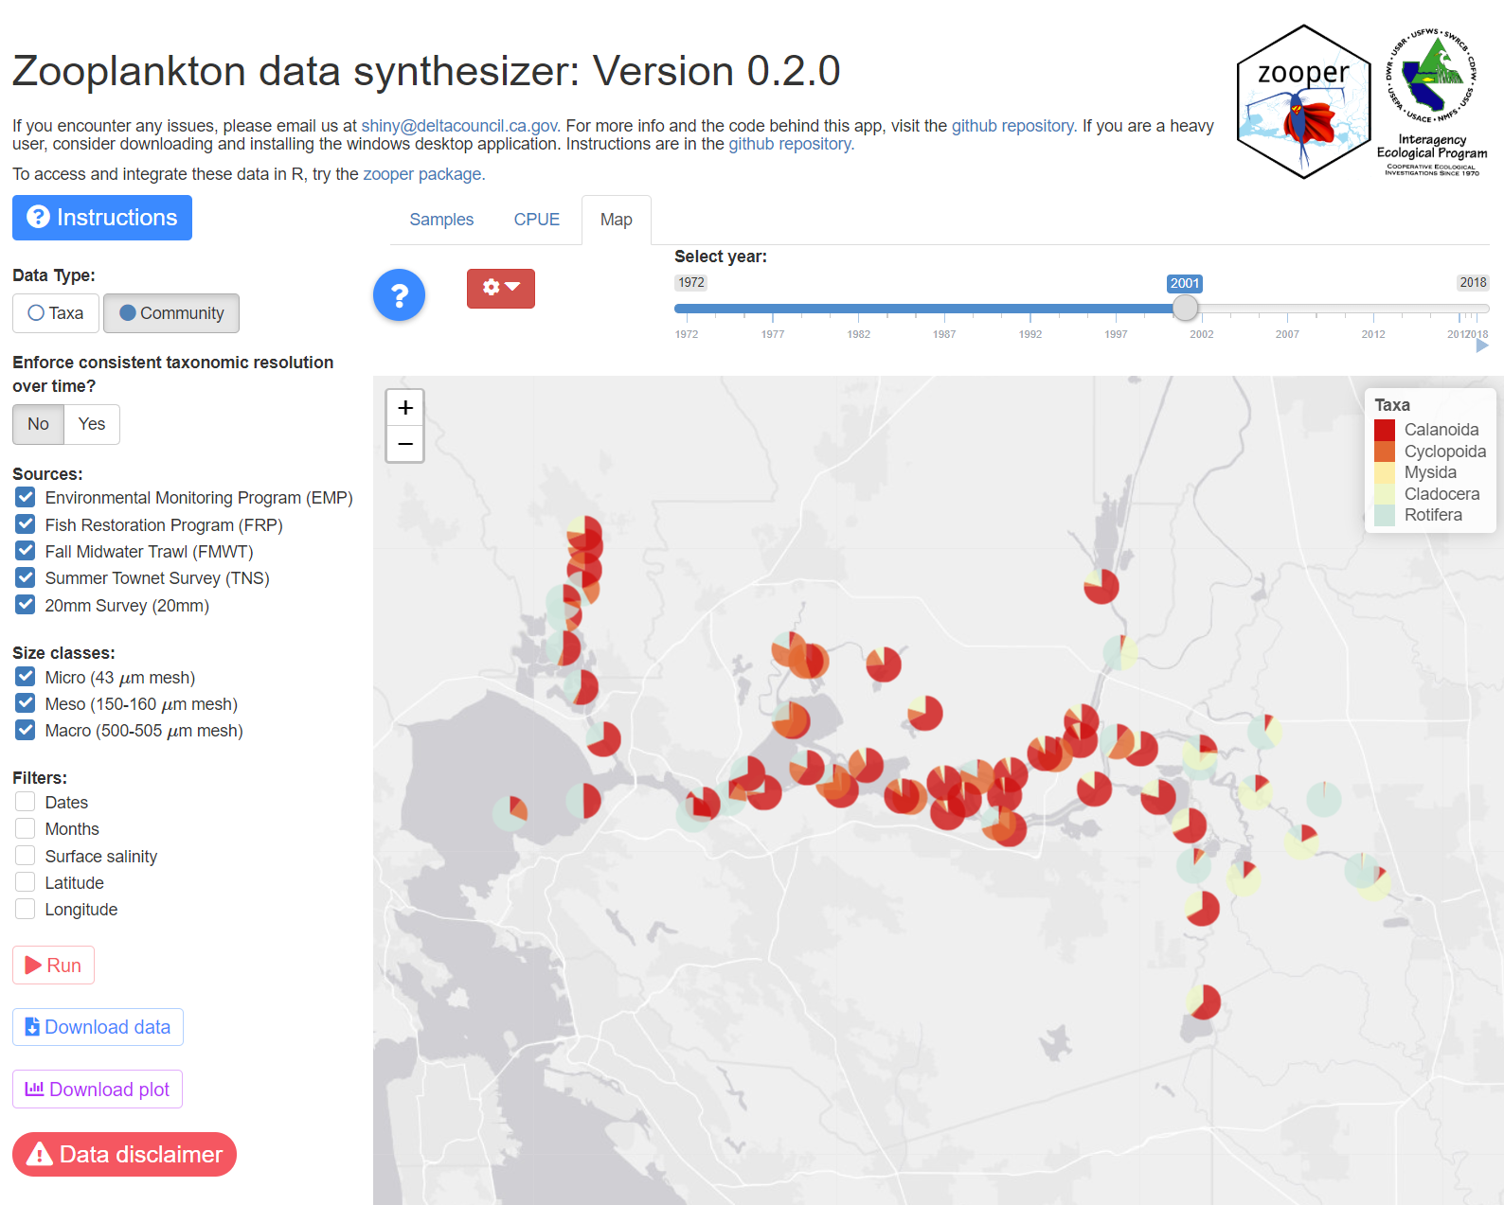
Why Shiny?
Bring R functionality to non-R-users.
Communicate science.
Toggle parameters and quickly visualize the effects.

Slide 4
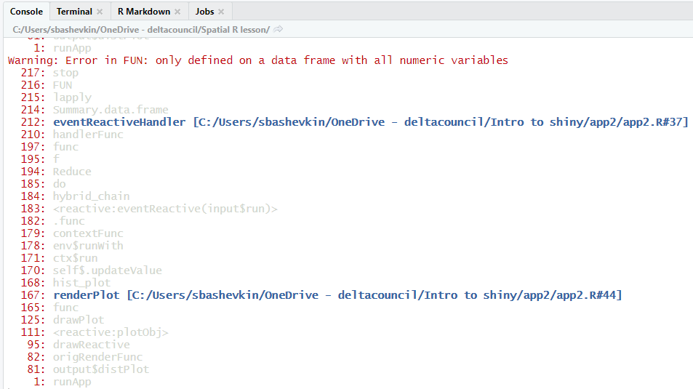
Why not shiny?
Reduce your frustration load
Show off your impressive coding skills
Build something you will not have the time to maintain

Slide 5
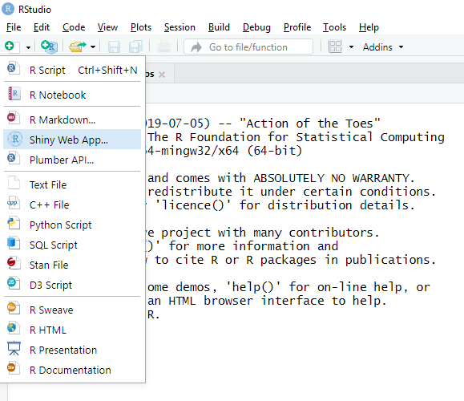
Basic shiny app

Slide 6
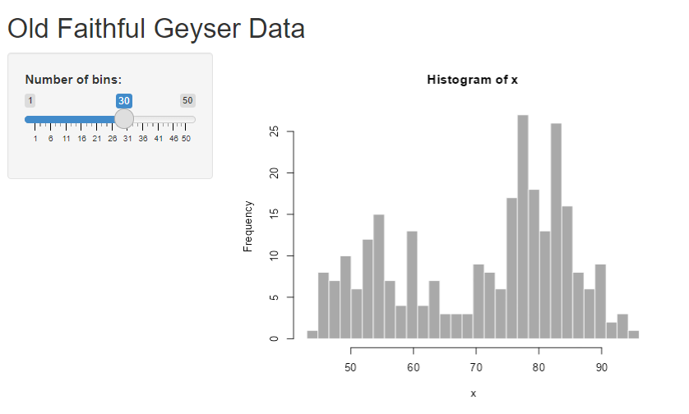
Basic shiny app

Slide 7
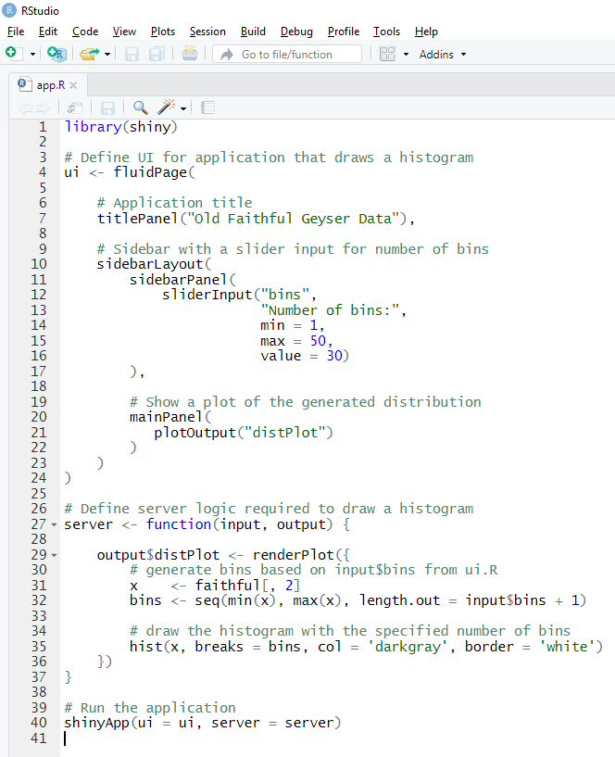
Basic shiny app
User interface
User inputs
Outputs (graphs, tables, text, etc.
Server
Notes:
Open R and run app

Slide 8
Basic shiny app
User interface
User input
Server

Slide 9
Basic shiny app
User interface
Graph output
Server

Slide 10
Shiny mechanics
The UI portion is analogous to a list of user-viewable components, wrapped in functions to set the layout

Slide 11
Shiny mechanics
Load things used by entire app (packages, functions, etc.)
Control layout

Slide 12
Shiny mechanics
The server portion is analogous to a series of functions with the inputs from the UI as arguments

Slide 13
Basic shiny app

Slide 14
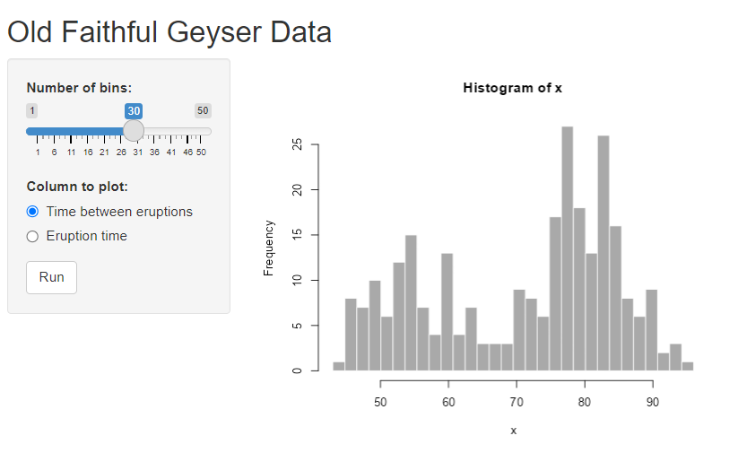
More complex functionality

Slide 15
More complex functionality
Use reactive to create intermediate values that will be triggered by any change in their dependencies (inputs).
If you don’t want everything to update as soon as the input changes, you can use eventReactive
Useful when the user must choose multiple inputs and you don’t want a process to trigger until they have made all their selections.

Slide 16
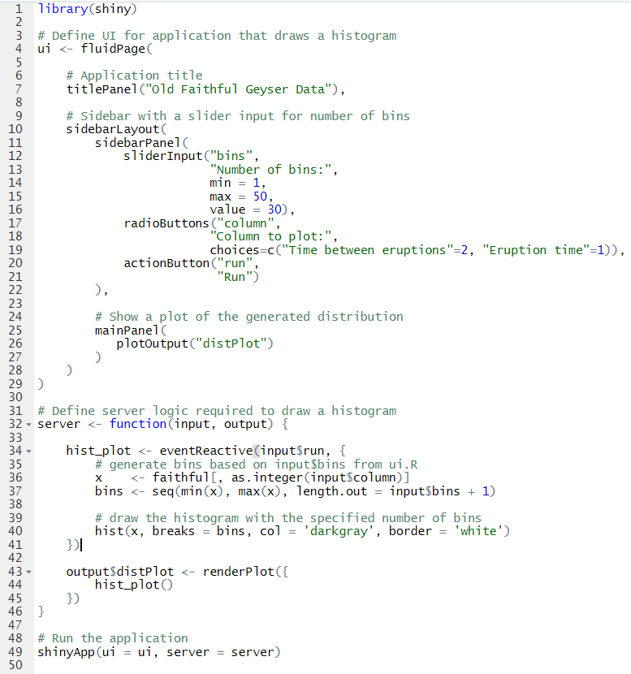
More complex functionality
Notes:
Changes are highlighted.

Slide 17
More complex functionality
UI additions
Server additions
Notes:
Open R and run app

Slide 18
More complex functionality

Slide 19
More complex app

Slide 20
Debugging
Shiny apps are hard to debug
Start by running code outside app.
Many bugs I have been unable to replicate outside the app have been related to an improper sequence of events.
Solution: Try the req function to ensure no processes trigger until their dependencies exist.
Also can set default values or use if and else to control the app.
Good
Bad
Input
Data
processing
Graph

Slide 21
Additional packages to improve your app
ggiraph or plotly: Hoverable interactive graphs
shinywidgets: More and prettier inputs
leaflet: interactive maps
leaflet.minicharts: pie and bar charts over maps
Can also customize app by inserting HTML or CSS

Slide 22
Deploying your app
Online at shinyapps.io
Free or paid account tiers
The Delta Science program has a paid account and may be willing to host your app
Or host it online on your own server if you have the time, skill, and money.

Slide 23
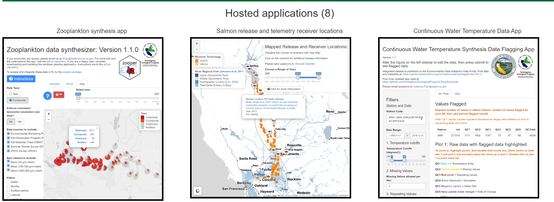
Example shiny apps from the Delta
https://baydeltalive.com/fish/hatchery-releases
https://deltascience.shinyapps.io/home (links to all DSP hosted apps)

Slide 24
Resources for learning
https://shiny.posit.co/r/articles/
https://shiny.posit.co/r/getstarted/shiny-basics/lesson1/index.html
https://shiny.posit.co/r/gallery/
Google

